Slide 1
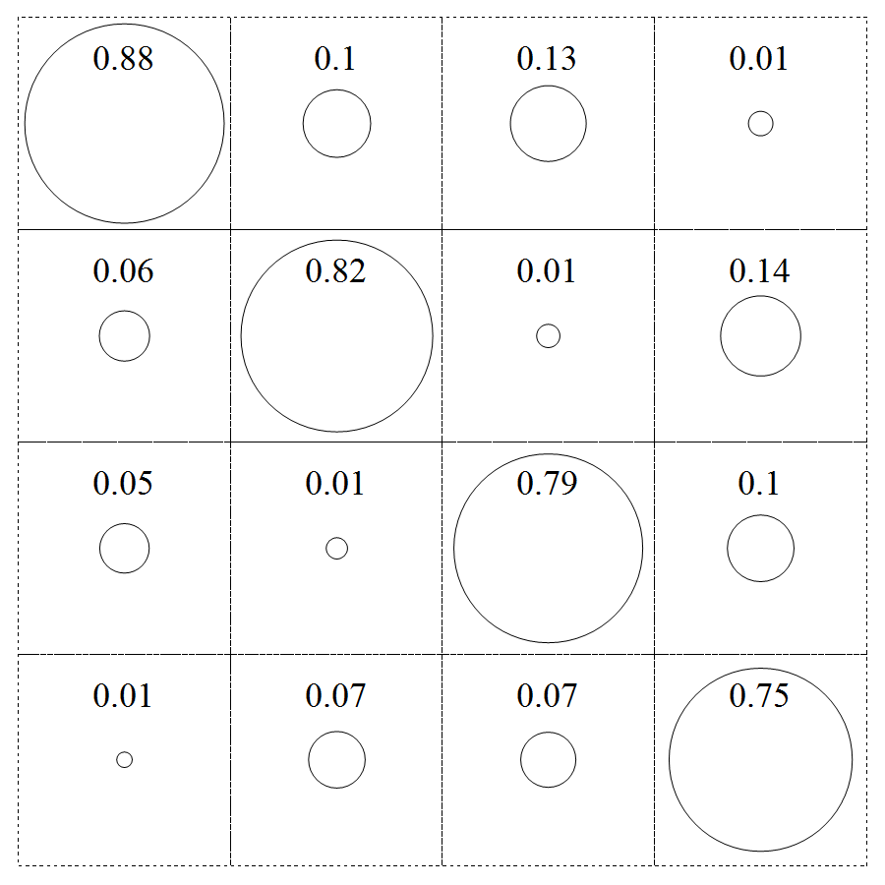
a)
b)
|00>
|01>
|10>
|11>
00
01
10
11

Slide 2
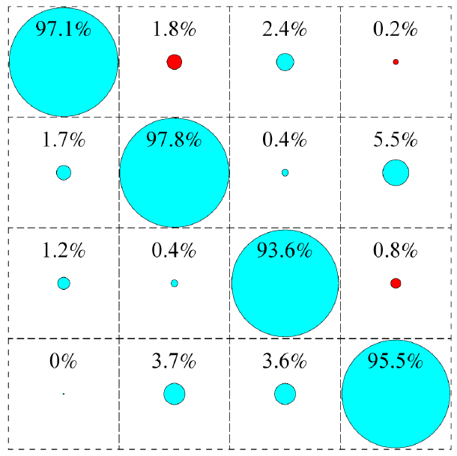
a)
b)
readout errors in |0>,|1> at A
readout errors in |0>,|2> at B
|1>
|0>
|1>
|0>
|2>
|0>
|2>
|0>
1
84%
85%
2
89%
88%
0
90%
88%
0
95%
95%
c)
00
02
20
22
00
02
20
22

Slide 4
readout errors in |0>,|1> at A
readout errors in |0>,|2> at B
|1>
|0>
|1>
|0>
|2>
|0>
|2>
|0>
1
84%
85%
2
89%
88%
0
90%
88%
0
95%
95%

Slide 5
00
02
20
22
00
02
20
22

